Slide 1
ONLINE FOOD DELIVERY SYSTEM
Presented by :
Aditya kishor more
Akash Goel
Appana Tulasi krishna
Basit Fayaz

Slide 2
ABSTRACT
The online Food delivery system is built using Spring Boot, Oracle SQL for Database, and Hibernate Framework.
This project is developed to manage the Online delivery of Food using an application.

Slide 3
The main motive of this application is to manage the Food items, Category of Food items, Product Items, Order in one place.
This project has both User and Admin access where Admin can add the food items and the User can order food using this application.

Slide 4
Technologies used
Database: Oracle Database 11g Express Edition
Back-End:Java , Spring Boot
Front-End: HTML CSS , JavaScript , ReactJs.

Slide 5
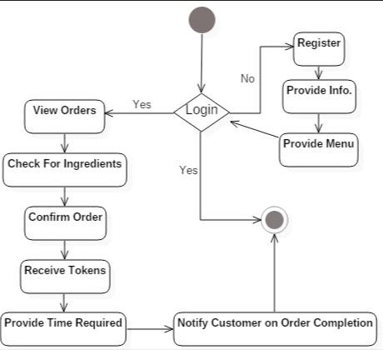
Activity diagram

Slide 6
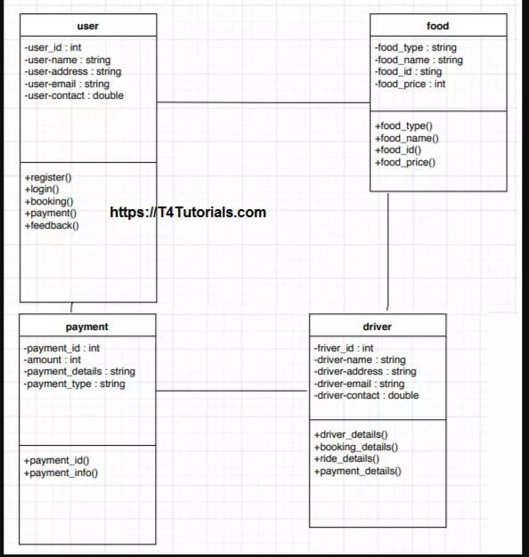
Class diagram

Slide 7
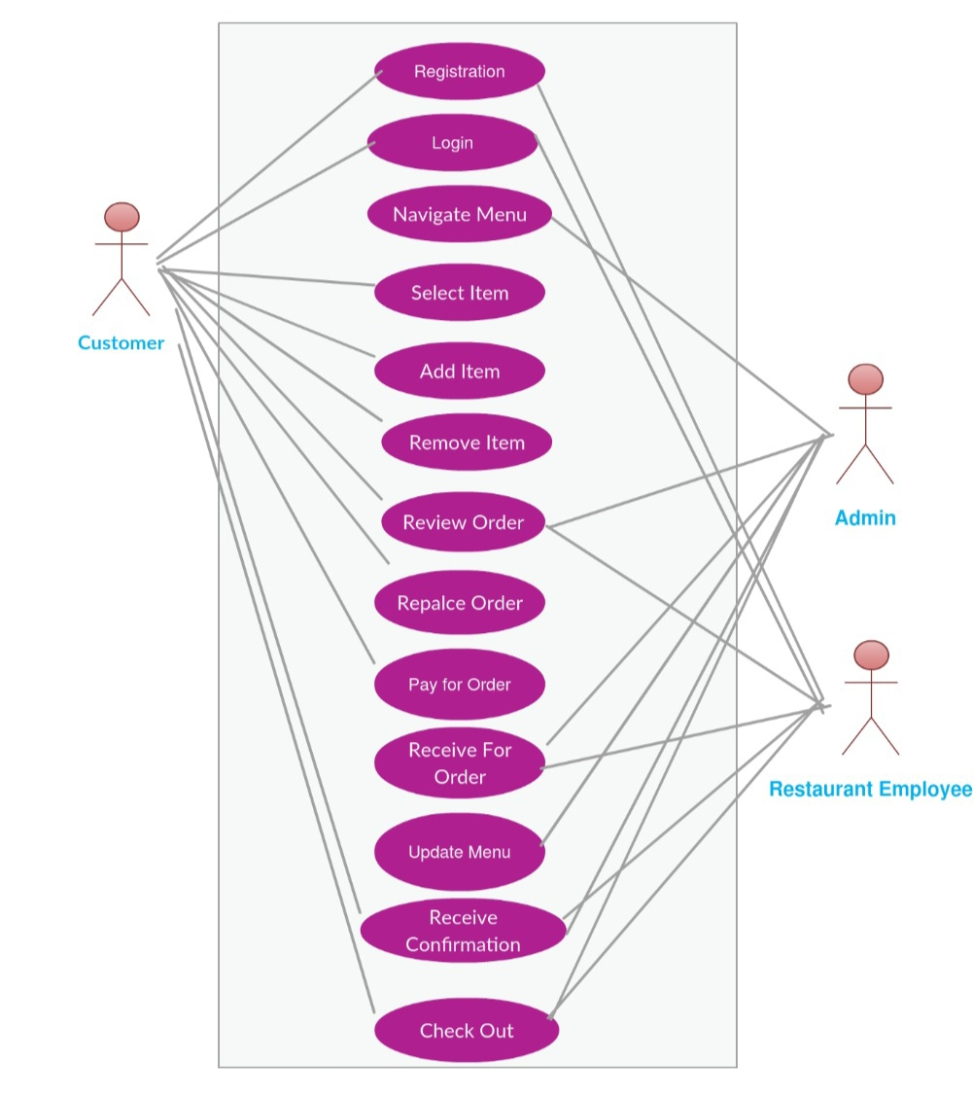
Case diagram

Slide 8
Modules:
Bill module
Cart module
Category module
Customer module
Item module
Order module
Restaurant module

Slide 9
Bill Module :
Billing is generally thought as a process which captures financial information, but the billing module we are building is more of a central workflow capturing module.
The billing module works as a connector of information capture between different departments inside the project.

Slide 10
Cart Module :
Cart module represents shopping cart management system.... Cart module manages customers accumulated list of items, calculates a total for the order, including shipping and handling charges and the associated taxes.

Slide 11
Category Module :
In Category module you may choose which category should be treated as a root category. The module will render a category tree starting from the chosen category.

Slide 12
Customer Module :
The Customer Information module is a component of the Bill Advisor that displays a customer's basic account information after the account has been opened. This module contains the following information: Name, Age, Gender, Mobile number, Mail Id.

Slide 13
Item Module :
The Item module is a catalogue of the products and services you are offering. Users have the possibility to create an enumerated database with descriptions and prices or to synchronize this with the accounting system.

Slide 14
Order Module :
An ordering module allows you to change the order that a collection of items appear in cart and we can proceed for order.

Slide 15
Restaurant Module :
In restaurant module, we do see the smoother order process followed by preparing the food order and making sure to deliver the same with the help of a delivery boy.

Slide 16
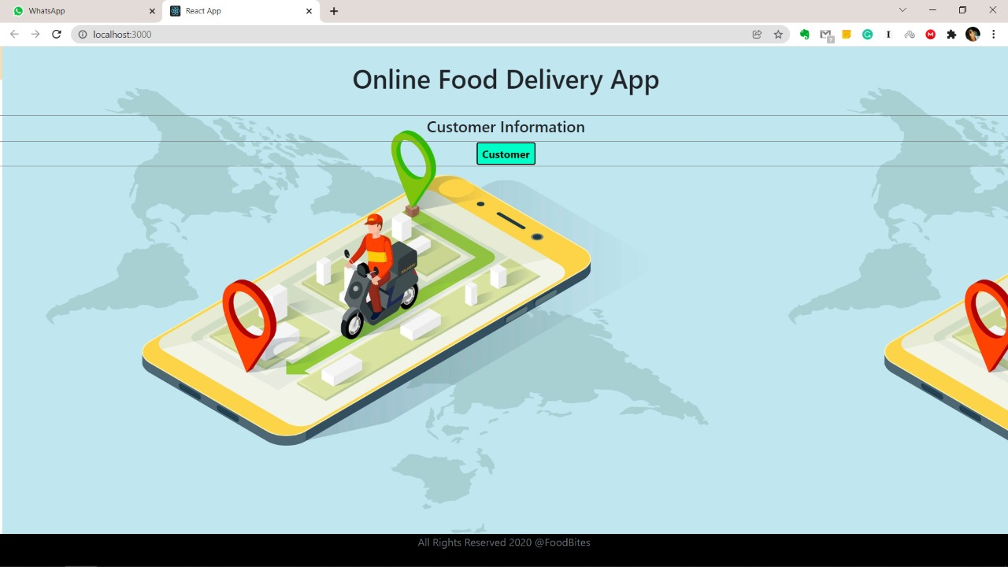

Slide 17
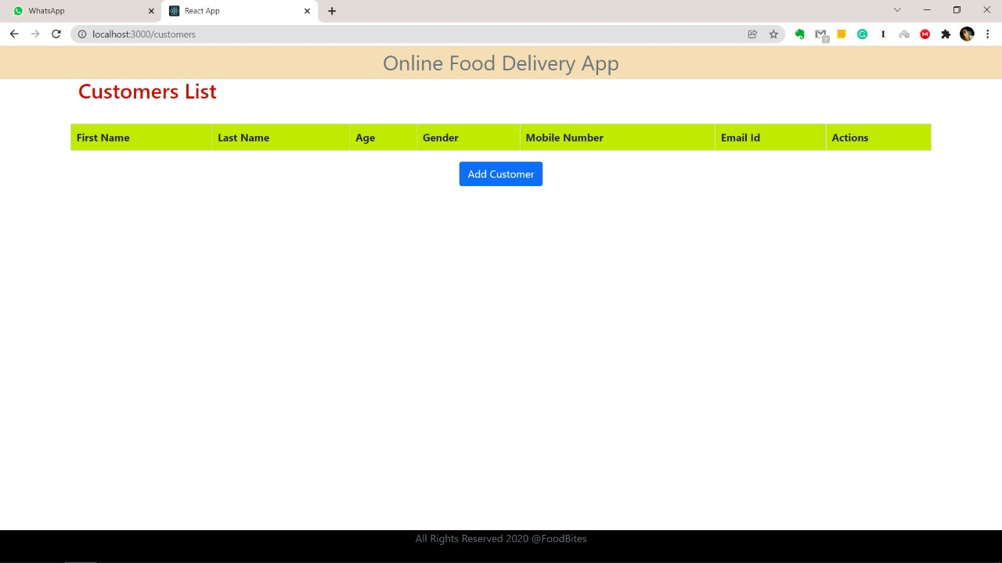

Slide 18
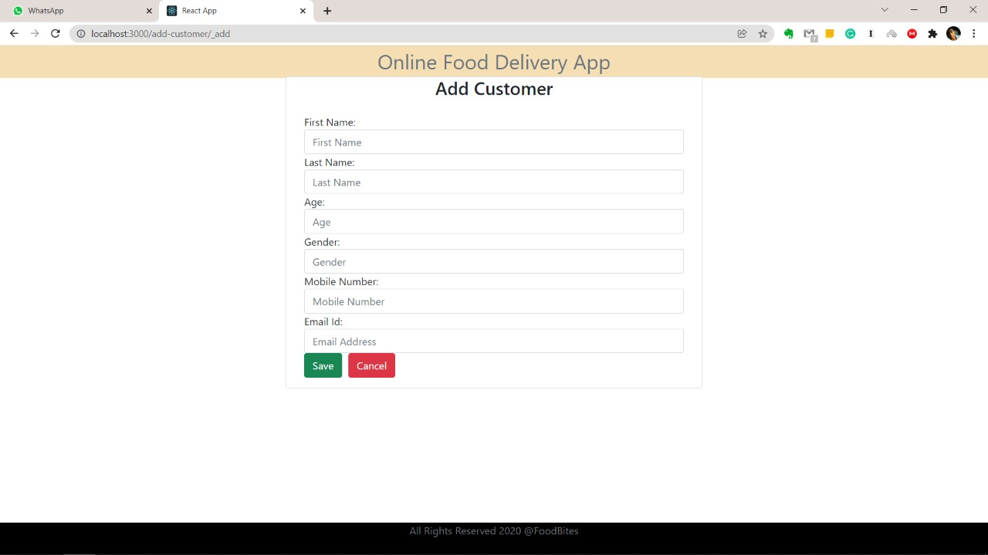

Slide 19
Thank You

